Slide 1


2nd International Conference on Recent Trends in Artificial Intelligence and Data Science (ICRTAIDS-2025) Organizer Department of Artificial Intelligence and Data Science AJEENKYA D Y PATIL SCHOOL OF ENGINEERING, LOHEGAON, PUNE
Osteoarthritis Prediction With Machine Learning
Track ID: 2_121
College Name: Ajeenkya DY Patil School of Engineering
Group Name: Disebuzz
Group Members: 1. Shilpa Patil
2.Omkar Tilekar
3. Yash Limbhore
4.Anuj Sharma
Guide Name: Prof. Ashwini Shinde

Slide 2
Outline
Introduction
Motivation
Problem Statement
Aims and Objectives
Literature Survey
Existing System
Proposed System
Algorithm and Modules
System Architecture
Implementation
Conclusion
Reference

Slide 3
Introduction
What is Arthritis?
Arthritis is a broad term that refers to inflammation of the joints.
It affects millions of people worldwide, causing pain, stiffness, and reduced mobility.
Common types include Osteoarthritis (OA), Rheumatoid Arthritis (RA), and Psoriatic Arthritis.
Osteoarthritis (OA)
Is a degenerative joint disease affecting millions worldwide.
Characterized by cartilage degradation, leading to pain, stiffness, and reduced mobility.
Early detection is crucial for effective treatment and improved quality of life.

Slide 4
Motivation
Challenges with Traditional OA Diagnosis
1. Late-stage detection: OA is often diagnosed only when significant joint damage has occurred.
2. Time-consuming & expensive: MRI scans and other advanced diagnostics are not always accessible.
Therefore it is necessary to detect osteoarthritis at an early stage to prevent irreversible damages.
1.Early Intervention-Early prediction allows for prompt treatment. This reduces disease progression.
2.Improved Outcomes-Timely interventions improve patient quality of life.
3.Resource Allocation-Prediction helps allocate healthcare resources efficiently.

Slide 5
Problem Statement
Develop an AI-driven system using machine learning for early osteoarthritis prediction.
By combining medical imaging, clinical data, and predictive modelling, this approach enables timely interventions, personalized treatment plans, and better patient outcomes.

Slide 6
Aims and Objectives
Early OA Detection: Identification of osteoarthritis at an early stage.
Improved Diagnostic Accuracy: Reduction in human error in radiographic assessments.
Scalability and Accessibility: AI-driven diagnosis for remote healthcare applications.
Personalized Treatment Planning: Tailoring interventions based on patient-specific data.

Slide 7
Literature Survey
Details of Paper | Problem identification | Paper approach for the problem | Results/Dataset
The application of machine learning in early diagnosis of osteoarthritis. | Early diagnosis of osteoarthritis is challenging as traditional diagnostic methods fail to detect OA in early stages. ML models require large datasets, but early-stage OA cases are often underrepresented. | The paper explores the role of ML in early OA diagnosis by combining advanced imaging techniques with ML-based models. It reviews recent advancements, limitations, and future research directions. | No specific dataset mentioned, but it discusses challenges in obtaining large annotated datasets for training ML models.
Knee Osteoarthritis Analysis Using Deep Learning and XAI on X-Rays. | CNN-based models automate diagnosis but lack interpretability, reducing trust. Training deep learning models requires extensive, well-annotated X-ray datasets, which are limited. | Tests five DL models on Kellgren-Lawrence graded images and integrates explainable AI to improve trust in model predictions. | EfficientNetB7 achieves 99.13% accuracy for normal vs. severe cases but drops to 67% for other classifications.
Understanding the role of machine learning in predicting progression of osteoarthritis. | Late detection of osteoarthritis causes irreversible damage, making early prediction crucial. Challenges include data security, patient consent, and bias in model predictions. | Uses ML to analyze complex datasets, including medical imaging, clinical records, and genetic factors, to develop predictive models for OA risk assessment. | No specific dataset mentioned, but highlights the need for standardized, well-annotated medical data.
Prediction Models for Knee Osteoarthritis: Review of Current Models and Future Directions. | No effective medical therapies exist to stop OA progression. ML models require extensive validation for real-world applications. | Reviews current OA prediction models, discussing their role in clinical decision-making and future directions for improving diagnosis. | Many models remain in research settings without widespread clinical adoption due to validation challenges.

Slide 8
Existing System
The current approach to osteoarthritis (OA) diagnosis relies on traditional medical imaging techniques like X-rays, MRI, and CT scans, along with manual assessment by radiologists. However, these methods have several limitations:
1.Late-Stage Detection: OA is often diagnosed only after significant joint damage, making early intervention difficult.
Subjectivity & Human Error: Radiographic grading systems like Kellgren-Lawrence (KL) score depend on visual assessment, leading to inconsistencies.
Time-Consuming & Expensive: Advanced imaging (MRI, CT) is costly and not always accessible, especially in remote areas.
Limited Scalability: Manual analysis requires trained professionals, restricting widespread screening.
Due to these challenges, an AI-driven approach is needed to enhance diagnostic accuracy, reduce human error, and enable early OA detection.

Slide 9
Proposed System
The proposed system aims to develop an AI-driven solution for early osteoarthritis (OA) prediction using deep learning-based image analysis. The system is designed to process X-ray images using deep learning models, particularly Convolutional Neural Networks (CNNs), for automated OA detection and severity classification.
Key Components:
1.) Data Collection and Preprocessing
2.) Deep Learning Model for OA Prediction
3.) Training and Optimization
4.) Model Evaluation and Deployment

Slide 10
Algorithm and Modules
Algorithm: CNN-Based Osteoarthritis Prediction
1.Input: X-ray images of knee joints.
2.Preprocessing: Resizing, noise reduction, augmentation.
Feature Extraction: CNN layers detect spatial patterns.
Classification & Prediction: Fully connected layers with Softmax/Sigmoid activation.
Training & Optimization: Cross-entropy loss, Adam optimizer, regularization.
Evaluation: Accuracy, precision, recall, F1-score, AUC-ROC.
Modules
1.Data Preprocessing: Collect & enhance X-ray images.
2.Deep Learning Model: CNN-based feature extraction & classification.
Training & Optimization: Fine-tuning hyperparameters & regularization.
Evaluation & Validation: Performance metrics & model testing.
Deployment: API/software integration for real-world use.

Slide 11
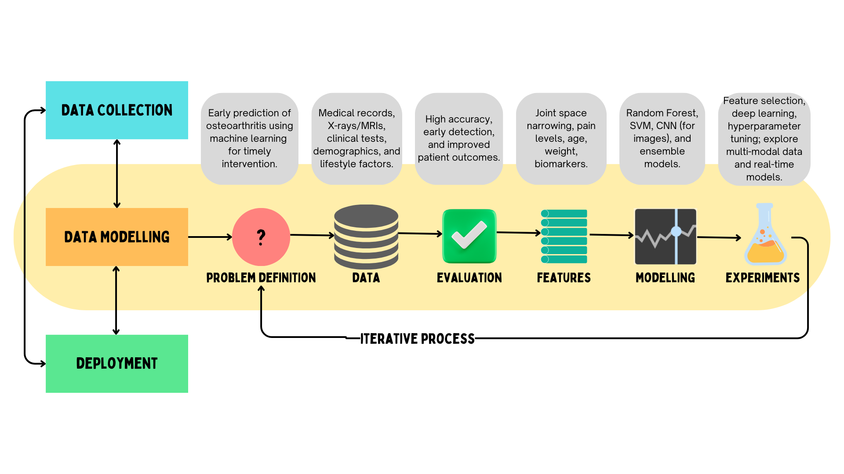
System Architecture

Slide 12
Implementation
The trained model was evaluated on a test set and its performance metrics were recorded.
The following are the results:
-Overall Loss: 1.8535
Currently, the model achieves an accuracy of 58.50%, which is expected to improve as it is trained on a larger and more diverse dataset. Expanding the dataset will enhance the model’s ability to recognize patterns, reduce overfitting, and improve generalization.
Additionally, fine-tuning hyperparameters, optimizing data augmentation techniques, and incorporating patient metadata could further boost performance, making the model more reliable for real-world clinical applications.

Slide 13
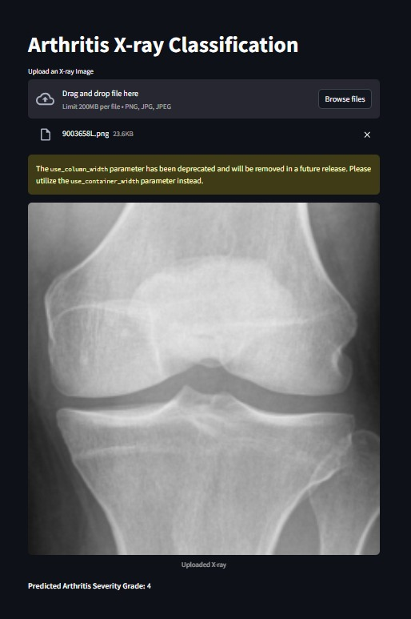
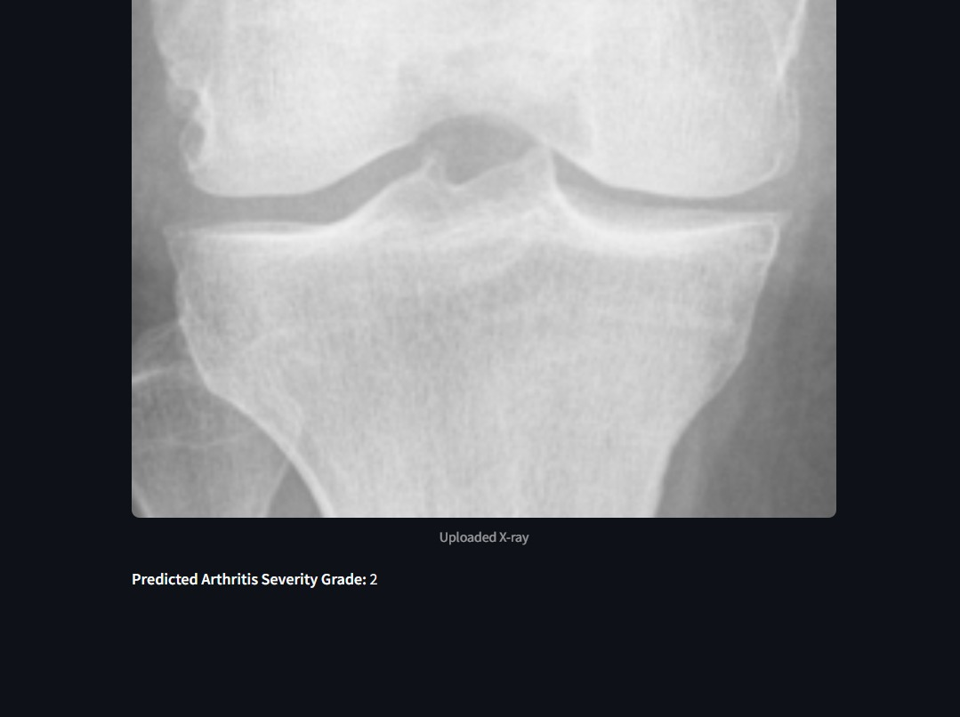

Slide 14
Conclusion
In a nutshell, AI integration in osteoarthritis detection enhances diagnostic accuracy, enables early detection, and improves patient care.
Advanced algorithms like CNN analyse medical imaging with high precision, paving the way for AI-driven personalized healthcare.
As technology evolves, machine learning promises to revolutionize OA diagnosis by improving speed and accuracy.

Slide 15
References
Sabat, S. K., Panda, S., Merli, P. K., & Bhuyan, S. K. (2022). Prevalence and correlates of arthritis in Indian older adults: Findings from the longitudinal aging study of India.International Journal of Health Sciences.
"Deep Learning for Osteoarthritis Diagnosis: A Review," IEEE, 2023.
"Predicting Osteoarthritis Progression Using Machine Learning," Nature Medicine, 2022.
"Automated Knee Osteoarthritis Detection via CNNs," Medical Imaging Journal, 2021.
Prevalence of the Knee Osteoarthritis Risk Factors Among Young Adult Population - An Observational Study, 2023.
Exploring the Burden of Knee Osteoarthritis in Rural South India: Community Prevalence, Risk Factors, and Functional Assessment Among Adults Aged 40 and Above,2024

Slide 16
Thank You

